Slide 1

OG & PR Compliance KPI Values
Dashboard & Improvement
Report
November 26, 2024

Slide 2
Introduction
This project focuses on creating a compliance dashboard for Oak Grove (OG) and Pine Ridge (PR), highlighting monthly and average semi-annual KPIs such as omission and
exceedance.
It involves automating data transformation from Rovisys SCADA and MyPlant systems, improving processing efficiency, and presenting a clear, user-friendly design with actionable insights.

Slide 3
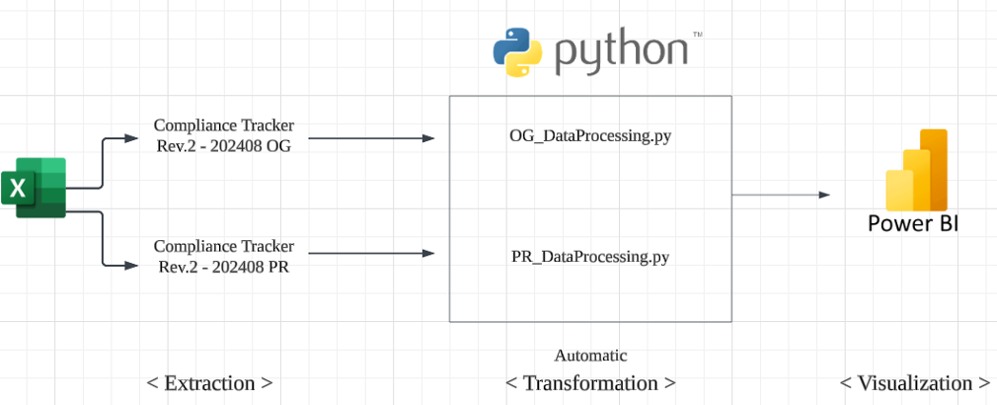
Data Flow

Slide 4
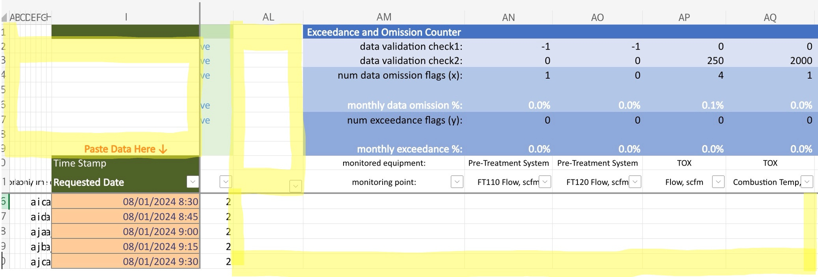
Extraction
< Compliance Tracker Rev.2 - 202408 OG >

Slide 5
Limitation in PowerBi Transformation
Repetitive Transformation Required
Each time a new file is imported, transformations must be redone manually.
No Reusable Logic Across Files
It is not possible to save the transformation logic from a sample file and apply it automatically to future files.
Structural Differences
The OG and PR files have different structures, making it impossible to use a unified transformation logic.

Slide 6
Transformation
Program Development
Created programs to transform input data for immediate use in Power BI dashboards.
Tailored Solutions
Designed two separate programs to handle the distinct data structures of OG and PR.
Real-Time Updates
Transformed data is automatically loaded into Power BI, enabling real-time updates on the dashboard.

Slide 7
Visualization
Let's check it through Power BI

Slide 8
Thank you

